Slide 1
Application Delivery Fundamentals : Javascript

Slide 2
Primitive Types & Reference Types in JavaScript
Facts
JavaScript has 2 kinds of variable types: primitive and reference.
A fixed amount of memory is reserved after creation of every variable.
When a variable is copied, it's in-memory value is copied.
Passing a variable to a function via a call also creates a copy of that variable.

Slide 3
Primitive Types
The in-memory value of a primitive type is it's actual value (e.g. boolean true, number 42). A primitive type can be stored in the fixed amount of memory available.
null
undefined
Boolean
Number
String
Primitive types are also known as: scalar types or simple types.

Slide 4
Reference Types
A reference type can contain other values. Since the contents of a reference type can not fit in the fixed amount of memory available for a variable, the in-memory value of a reference type is the reference itself (a memory address).
Array
Object
Function
Reference types are also known as: complex types or container types.

Slide 5
Copying a primitive:
var a = 13 // assign `13` to `a`
var b = a // copy the value of `a` to `b`
b = 37 // assign `37` to `b`
console.log(a) // => 13

Slide 6
Copying a reference:
var a = { c: 13 } // assign the reference of a new object to `a`
var b = a // copy the reference of the object inside `a` to new variable `b`
b.c = 37 // modify the contents of the object `b` refers to
console.log(a) // => { c: 37 }

Slide 7
Dynamically creating properties on objects using javascript
var dictionary = {
lettuce: 'a veggie',
banana: 'a fruit',
tomato: 'it depends on who you ask',
apple: 'a fruit',
Apple: 'Steve Jobs rocks!' // properties are case-sensitive
}
var word = prompt('What word would you like to look up today?')
var definition = dictionary[word]
alert(word + '\n\n' + definition)

Slide 8
Argument Passing
Javascript is a functional language meaning that functions are the primary modular units of execution.
Parameters are variables listed as a part of the function definition.
Arguments are values passed to the function when it is invoked.

Slide 9
Argument Passing
JavaScript does not throw an error if the number of arguments passed during a function invocation are different than the number of parameters listed during function definition.
This should make it clear that parameters and arguments should be treated as two different entities.

Slide 10
Argument Passing
// Basic function with three parameters that logs the sum of all the parameters
function argCheck(parameter1, parameter2, parameter3){
console.log(parameter1 + parameter2 + parameter3);
}
// Function with extra arguments
argCheck(1,2,3,4);
// Logs 6 (1 + 2 + 3, ignores 4)

Slide 11
Argument Passing
// Function with missing arguments
argCheck(1,2);
// Logs NaN because by default if a corresponding argument is missing, it is set to undefined.
// parameter3 is assigned undefined and so 1+2+undefined = NaN
// Note that, no error is thrown

Slide 12
The arguments parameter
The arguments parameter is implicitly passed just like the this parameter.
It is a local variable accessible within all functions and contains an entry for each argument passed to that function.
The arguments object is an array-like construct which can be used to access arguments passed to the function even if a matching parameter isn’t explicitly defined.

Slide 13
The arguments parameter
function argumentVar(parameter1, parameter2, parameter3){
console.log(arguments.length); // Logs the number of arguments passed.
console.log(arguments[3]); // Logs the 4th argument. Follows array indexing notations.
}
argumentVar(1,2,3,4,5);
// Log would be as follows
// 5
// 4
// 5 is the number of arguments
// 4 is the 4th argument

Slide 14
Determining Type
The typeof operator returns a string indicating the type of the unevaluated operand.
console.log(typeof 42);// expected output: "number“
console.log(typeof 'blubber');// expected output: "string“
console.log(typeof true);// expected output: "boolean“
console.log(typeof declaredButUndefinedVariable);// expected output: "undefined";

Slide 15
Scope
Scope determines the visibility or accessibility of a variable or other resource in the area of your code.
Global Scope
There's only one Global scope in the JavaScript document.
The area outside all the functions is consider the global scope and the variables defined inside the global scope can be accessed and altered in any other scopes.

Slide 16
Scope
Local Scope
Variables declared inside the functions become Local to the function and are considered in the corresponding local scope.
Every Functions has its own scope.
Same variable can be used in different functions because they are bound to the respective functions and are not mutual visible.

Slide 17
Scope
Local scope can be divided into function scope and block scope.
The concept of block scope is introduced in ECMA script 6 (ES6) together with the new ways to declare variables -- const and let.
Function Scope
Whenever one declare a variable in a function, the variable is visible only within the function. Y
One can't access it outside the function.
var is the keyword to define variable for a function-scope accessibility.

Slide 18
Scope
Block Scope
A block scope is the area within if, switch conditions or for and while loops.
Generally speaking, whenever you see {curly brackets}, it is a block.
In ES6, const and let keywords allow developers to declare variables in the block scope, which means those variables exist only within the corresponding block.

Slide 19
Scope
function foo(){
if(true){
var fruit1 = 'apple'; //exist in function scope
const fruit2 = 'banana'; //exist in block scope
let fruit3 = 'strawberry'; //exist in block scope
}
console.log(fruit1);
console.log(fruit2);
console.log(fruit3);
}
foo();

Slide 20
Scope
//result:
//apple
//error: fruit2 is not defined
//error: fruit3 is not defined

Slide 21
Scope
Lexical Scope
Another point to mention is the lexical scope.
Lexical scope means the children scope have the access to the variables defined in the parent scope.
The children functions are lexically bound to the execution context of their parents.

Slide 22
Scope
function foo1(){
var fruit1 = 'apple';
const fruit2 = 'banana';
let fruit3 = 'strawberry';
function foo2(){
console.log(fruit1);
console.log(fruit2);
console.log(fruit3);
}
foo2();
}
foo1();

Slide 23
Scope
//result:
//apple
//banana
//strawberry

Slide 24
Scope
No Block Level Scope
JavaScript does not allow block level scope inside { }.
For example, variables defined in if block can be accessed outside if block, inside a function.

Slide 25
Execution context, Scope chain and JavaScript internals
Execution context (EC) is defined as the environment in which JavaScript code is executed.
Execution context in JavaScript are of three types:
Global execution context (GEC): This is the default execution context in which JS code start its execution when the file first loads in the browser. All the global code are executed inside global execution context.

Slide 26
Execution context, Scope chain and JavaScript internals
Functional execution context (FEC): Functional execution context is defined as the context created by the execution of code inside a function.
Each function has its own execution context. It can be more than one.
Functional execution context have access to all the code of global execution context.

Slide 27
Execution context, Scope chain and JavaScript internals
Eval: Execution context inside eval function.

Slide 28
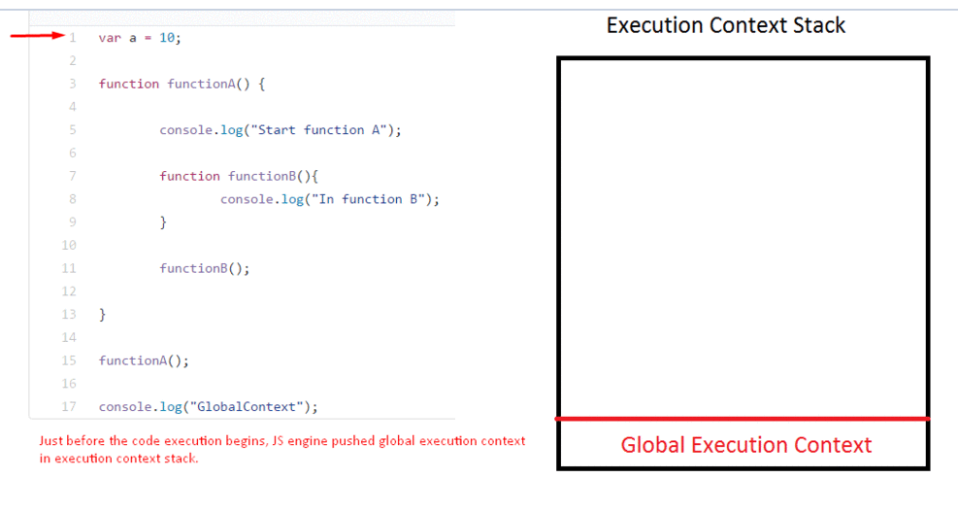
Execution context stack (ECS):

Slide 29
Execution Context
JavaScript engine creates the execution context in the following two stages:
Creation phase
Execution phase
Creation phase is the phase in which JS engines has called a function but its execution has not started. In the creation phase, JS engine is in the compilation phase and it scans over the function to compile the code.

Slide 30
Execution Context
In creation phase, JS engine performs the following task:
Creates the Activation object or the variable object:
Activation object is a special object in JS which contain all the variables, function arguments and inner functions declarations information.
As activation object is a special object it does not have the dunder proto property.
Creates the scope chain:
Once the activation object gets created, JS engine initializes the scope chain which is a list of all the variables objects inside which the current function exists.
This also includes the variable object of global execution context. Scope chain also contains the current function variable object.
Determines the value of this:
After the scope chain, JavaScript engine initialize the value of ‘this’.

Slide 31
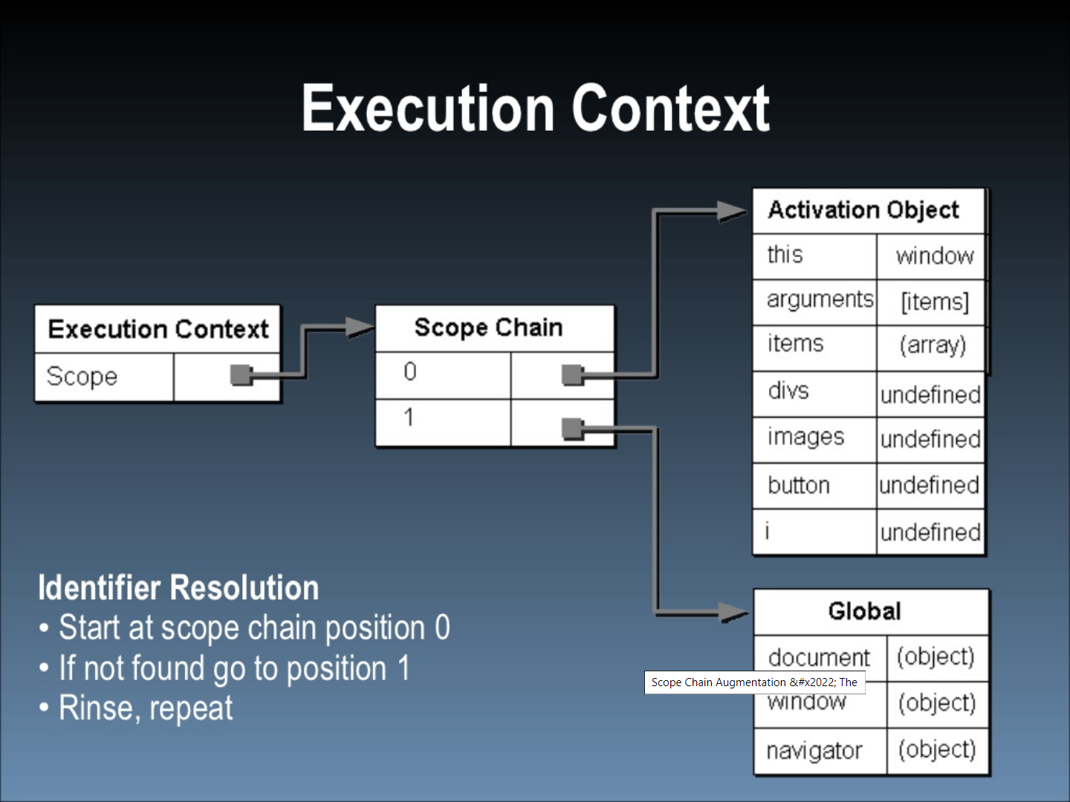

Slide 32
Execution Context
Execution phase:
In the execution phase, JS engines will again scan through the function to update the variable object with the values of the variables and will execute the code.

Slide 33
Scope Chain Augmentation
There are two primary types of execution contexts, global and function.
There are other ways to augment the scope chain.
Certain statements add a temporary scope to the front of the scope chain that is later removed after code execution.
There are two statements that can create new scope:
The catch block in a try-catch statement
A with statement
Both of these statements add a variable object to the front of the scope chain.

Slide 34
With Statement
function buildUrl() {
var qs = "new value";
with(location){
var url = href + qs;
}
return url;
}

Slide 35
Memory
JavaScript automatically allocates memory when objects are created and frees it when they are not used anymore (garbage collection).

Slide 36
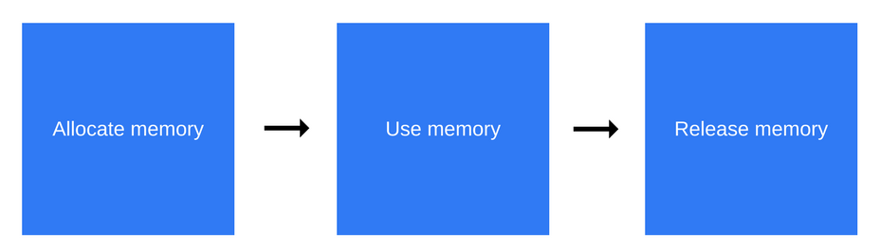
Memory life cycle

Slide 37
Memory Allocation
JavaScript relieves developers from the responsibility to handle memory allocations — JavaScript does it by itself, alongside declaring values.

Slide 38
Allocation in JavaScript - Value initialization
var n = 123; // allocates memory for a number
var s = 'azerty'; // allocates memory for a string
var o = {
a: 1,
b: null
}; // allocates memory for an object and contained values
// (like object) allocates memory for the array and
// contained values
var a = [1, null, 'abra'];

Slide 39
Allocation in JavaScript - Value initialization
var d = new Date(); // allocates a Date object
var e = document.createElement('div'); // allocates a DOM element

Slide 40
Memory Allocation
Using values
Using values basically means reading and writing in allocated memory.
This can be done by reading or writing the value of a variable or an object property or even passing an argument to a function.

Slide 41
Memory Allocation
Release when the memory is not needed anymore
The majority of memory management issues occur at this phase.
The most difficult aspect of this stage is determining when the allocated memory is no longer needed.
Low-level languages require the developer to manually determine at which point in the program the allocated memory is no longer needed and to release it.

Slide 42
Memory Allocation
Some high-level languages, such as JavaScript, utilize a form of automatic memory management known as garbage collection (GC).
The purpose of a garbage collector is to monitor memory allocation and determine when a block of allocated memory is no longer needed and reclaim it.
This automatic process is an approximation since the general problem of determining whether or not a specific piece of memory is still needed is undecidable.

Slide 43
Garbage Collection
The main concept that garbage collection algorithms rely on is the concept of reference.
Within the context of memory management, an object is said to reference another object if the former has access to the latter (either implicitly or explicitly).
For instance, a JavaScript object has a reference to its prototype (implicit reference) and to its properties values (explicit reference).

Slide 44
Reference-counting garbage collection
This is the most naive garbage collection algorithm.
This algorithm reduces the problem from determining whether or not an object is still needed to determining if an object still has any other objects referencing it.
An object is said to be "garbage", or collectible if there are zero references pointing to it.

Slide 45
Reference-counting garbage collection
var x = {
a: {
b: 2
}
};
// 2 objects are created. One is referenced by the other as one of its properties.
// The other is referenced by virtue of being assigned to the 'x' variable.
// Obviously, none can be garbage-collected.

Slide 46
Reference-counting garbage collection
var y = x; // The 'y' variable is the second thing that has a reference to the object.
x = 1; // Now, the object that was originally in 'x' has a unique reference
// embodied by the 'y' variable.
var z = y.a; // Reference to 'a' property of the object.
// This object now has 2 references: one as a property,
// the other as the 'z' variable.

Slide 47
Reference-counting garbage collection
y = 'mozilla'; // The object that was originally in 'x' has now zero
// references to it. It can be garbage-collected.
// However its 'a' property is still referenced by
// the 'z' variable, so it cannot be freed.
z = null; // The 'a' property of the object originally in x
// has zero references to it. It can be garbage collected.

Slide 48
Limitation: Circular references
There is a limitation when it comes to circular references.
In the following example, two objects are created with properties that reference one another, thus creating a cycle.
They will go out of scope after the function call has completed.
At that point they become unneeded and their allocated memory should be reclaimed.

Slide 49
Limitation: Circular references
However, the reference-counting algorithm will not consider them reclaimable since each of the two objects has at least one reference pointing to them, resulting in neither of them being marked for garbage collection.
Circular references are a common cause of memory leaks.

Slide 50
Limitation: Circular references
function f() {
var x = {};
var y = {};
x.a = y; // x references y
y.a = x; // y references x
return 'azerty';
}
f();

Slide 51
Limitation: Circular references
var div;
window.onload = function() {
div = document.getElementById('myDivElement');
div.circularReference = div;
div.lotsOfData = new Array(10000).join('*');
};

Slide 52
Mark-and-sweep algorithm
This algorithm reduces the definition of "an object is no longer needed" to "an object is unreachable".
This algorithm assumes the knowledge of a set of objects called roots.
In JavaScript, the root is the global object.
Periodically, the garbage collector will start from these roots, find all objects that are referenced from these roots, then all objects referenced from these, etc.
Starting from the roots, the garbage collector will thus find all reachable objects and collect all non-reachable objects.

Slide 53
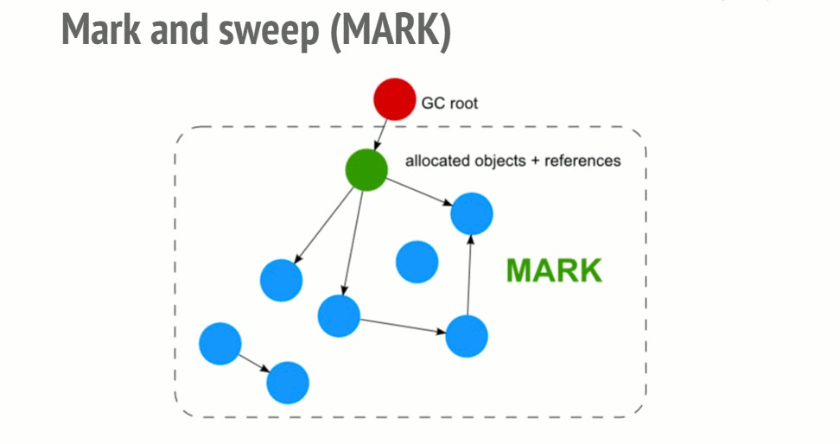
Mark-and-sweep algorithm

Slide 54
Mark-and-sweep algorithm
This algorithm is an improvement over the previous one since an object having zero references is effectively unreachable.
The opposite does not hold true as we have seen with circular references.
As of 2012, all modern browsers ship a mark-and-sweep garbage-collector.
All improvements made in the field of JavaScript garbage collection (generational/incremental/concurrent/parallel garbage collection) over the last few years are implementation improvements of this algorithm.

Slide 55
Garbage Collection
Cycles are no longer a problem
In the first example above, after the function call returns, the two objects are no longer referenced by any resource that is reachable from the global object.
Consequently, they will be found unreachable by the garbage collector and have their allocated memory reclaimed.

Slide 56
Garbage Collection
Limitation: Releasing memory manually
There are times when it would be convenient to manually decide when and what memory is released.
In order to release the memory of an object, it needs to be made explicitly unreachable.

Slide 57
Regular Expression
Method | Description
exec | A RegExp method that executes a search for a match in a string. It returns an array of information or null on a mismatch.
test | A RegExp method that tests for a match in a string. It returns true or false.
match | A String method that returns an array containing all of the matches, including capturing groups, or null if no match is found.
matchAll | A String method that returns an iterator containing all of the matches, including capturing groups.
search | A String method that tests for a match in a string. It returns the index of the match, or -1 if the search fails.
replace | A String method that executes a search for a match in a string, and replaces the matched substring with a replacement substring.
split | A String method that uses a regular expression or a fixed string to break a string into an array of substrings.

Slide 58
ECMA Standards
ECMA stands for - European Computer Manufacturer's Association.
ECMAScript is a standard for a scripting language. It specifies the core features that a scripting language should provide and how those features should be implemented.
Javascript was originally created at Netscape, and they wanted to standardize the language. So, they submitted the language to the European Computer Manufacturer’s Association (ECMA) for standardization
JavaScript is what everyone calls the language, but that name is trademarked (by Oracle, which inherited the trademark from Sun).

Slide 59
Goals for ES6
Be a better language for writing
i. complex applications;
ii. libraries (possibly including the DOM) shared by those applications;
iii. code generators targeting the new edition.

Slide 60
Goals for ES6
Improve interoperation
The goal is: Improve interoperation, adopting de facto standards where possible.
Classes: are based on how constructor functions are currently used.
Modules: picked up design ideas from the CommonJS module format.
Arrow functions: have syntax that is borrowed from CoffeeScript.
Named function parameters:

Slide 61
Goals for ES6
Versioning
The goal is: Keep versioning as simple and linear as possible.

Slide 62
Categories of ES6 features
Better syntax for features that already exist (e.g. via libraries). For example:
– Classes
– Modules
• New functionality in the standard library. For example:
– New methods for strings and Arrays
– Promises
– Maps, Sets
• Completely new features. For example:
– Generators
– Proxies
– WeakMaps

Slide 63
A brief history of ECMAScript
Ver | Official Name | Description
1 | ECMAScript 1 (1997) | First Edition.
2 | ECMAScript 2 (1998) | Editorial changes only.
3 | ECMAScript 3 (1999) | Added Regular Expressions. Added try/catch.
4 | ECMAScript 4 | Never released.
5 | ECMAScript 5 (2009) Read More: JS ES5 | Added "strict mode". Added JSON support. Added String.trim(). Added Array.isArray(). Added Array Iteration Methods.

Slide 64
A brief history of ECMAScript
5.1 | ECMAScript 5.1 (2011) | Editorial changes.
6 | ECMAScript 2015 | Added let and const. Added default parameter values. Added Array.find(). Added Array.findIndex().
7 | ECMAScript 2016 | Added exponential operator (**). Added Array.prototype.includes.
8 | ECMAScript 2017 | Added string padding. Added new Object properties. Added Async functions. Added Shared Memory.
9 | ECMAScript 2018 | Added rest / spread properties. Added Asynchronous iteration. Added Promise.finally(). Additions to RegExp.

Slide 65
Core ES6 Features
From var to let/const
From IIFEs to blocks
In ES5, you had to use an IIFE if you wanted to keep a variable local:
(function () { // open IIFE
var tmp = ···;
···
}()); // close IIFE
console.log(tmp); // ReferenceError

Slide 66
Core ES6 Features
Avoid IIFEs in ES6
Replace an IIFE with a block
{ // open block
let tmp = ···;
···
} // close block
console.log(tmp); //ReferenceError

Slide 67
Core ES6 Features
From concatenating strings to template literals
String interpolation
In ES5, you put values into strings by concatenating those values and string fragments:
function printCoord(x, y) {
console.log('('+x+', '+y+')');
}
In ES6 you can use string interpolation via template literals:
function printCoord(x, y) {
console.log(`(${x}, ${y})`);
}

Slide 68
Core ES6 Features
Multi-line strings
ES5
var HTML5_SKELETON =
'<!doctype html>\n' +
'<html>\n' +
'<head>\n‘
ES6
var HTML5_SKELETON = '\
<!doctype html>\n\
<html>\n\’

Slide 69
Core ES6 Features
From function expressions to arrow functions
In ES5, such callbacks are relatively verbose:
var arr = [1, 2, 3];
var squares = arr.map(function (x) { return x * x });
In ES6, arrow functions are much more concise:
const arr = [1, 2, 3];
const squares = arr.map(x => x * x);

Slide 70
Core ES6 Features
Handling multiple return values
Multiple return values via arrays
In ES6, destructuring makes this code simpler:
const [, year, month, day] =
/^(\d\d\d\d)-(\d\d)-(\d\d)$/.exec('2999-12-31');

Slide 71
Core ES6 Features
Object Destructuring
const wes = {
first: 'Wes',
last: 'Bos',
links: {
social: {
twitter: 'https://twitter.com/wesbos',
facebook: 'https://facebook.com/wesbos.developer',
},
web: {
blog: 'https://wesbos.com'
}
}
};

Slide 72
Core ES6 Features
Object Destructuring
const { twitter, facebook } = wes.links.social;
console.log(twitter, facebook); // logs the 2 variables

Slide 73
Core ES6 Features
From for to forEach() to for-of
const arr = ['a', 'b', 'c'];
for (const elem of arr) {
console.log(elem);
}
for (const [index, elem] of arr.entries()) {
console.log(index+'. '+elem);
}

Slide 74
Core ES6 Features
Handling parameter default values
function foo(x=0, y=0) {
···
}

Slide 75
Core ES6 Features
Handling named parameters
let myFunc = function({x = 5,y = 8,z = 13} = {}) {
console.log(x,y,z);
};
myFunc({y:15,x:10,a:1}); //10 15 13

Slide 76
Core ES6 Features
Handling named parameters
myFunc = function({x = 5,y = 8,z = 13} = {x:1,y:2,z:3}) {
console.log(x,y,z);
};
myFunc(); //1 2 3 (hits the object literal default)
myFunc({}); //5 8 13 (hits the value defaults)

Slide 77
Core ES6 Features
Handling named parameters
//destructuring to assign parameters
let myFunc = function({x,y,z}) {
console.log(x,y,z);
};
myFunc({x:10,y:20,z:30}); //10 20 30

Slide 78
Core ES6 Features
Making the parameter optional
function selectEntries(start=0, end,step) {
···
}

Slide 79
Core ES6 Features
From arguments to rest parameters
function format(pattern, ...args) {
···
}

Slide 80
Core ES6 Features
From apply() to the spread operator (...)
Math.max() returns the numerically greatest of its arguments. It works for an arbitrary number of arguments, but not for Arrays.
ES5 – apply():
> Math.max.apply(Math, [-1, 5, 11, 3])
11
ES6 – spread operator:
> Math.max(...[-1, 5, 11, 3])
11

Slide 81
Core ES6 Features
Array.prototype.push()
ES5 – apply():
var arr1 = ['a', 'b'];
var arr2 = ['c', 'd'];
arr1.push.apply(arr1, arr2);
// arr1 is now ['a', 'b', 'c', 'd']

Slide 82
Core ES6 Features
Array.prototype.push()
In ES6
const arr1 = ['a', 'b'];
const arr2 = ['c', 'd'];
arr1.push(...arr2);
// arr1 is now ['a', 'b', 'c', 'd']

Slide 83
Core ES6 Features
From concat() to the spread operator (...)
ES5 – concat():
var arr1 = ['a', 'b'];
var arr2 = ['c'];
var arr3 = ['d', 'e'];
console.log(arr1.concat(arr2, arr3));

Slide 84
Core ES6 Features
From concat() to the spread operator (...)
ES6 – spread operator:
const arr1 = ['a', 'b'];
const arr2 = ['c'];
const arr3 = ['d', 'e'];
console.log([...arr1, ...arr2, ...arr3]);

Slide 85
Core ES6 Features
From function expressions in object literals to method definitions
In ES 5
var obj = {
foo: function () {
···
},
bar: function () {
this.foo();
}, // trailing comma is legal in ES5
}

Slide 86
Core ES6 Features
From function expressions in object literals to method definitions
ES6 has method definitions, special syntax for creating methods:
const obj = {
foo() {
···
},
bar() {
this.foo();
},
}

Slide 87
Core ES6 Features
From constructors to classes
Derived classes
From objects to Maps
const map = new Map();
function countWords(word) {
const count = map.get(word) || 0;
map.set(word, count + 1);
}

Slide 88
Core ES6 Features
New string methods
if (str.indexOf('x') === 0) {} // ES5
if (str.startsWith('x')) {} // ES6
if (str.indexOf('x') >= 0) {} // ES5
if (str.includes('x')) {} // ES6
new Array(3+1).join('#') // ES5
'#'.repeat(3) // ES6

Slide 89
Core ES6 Features
New string methods
> 'hello'.startsWith('hell')
true
> 'hello'.endsWith('ello')
true
> 'hello'.includes('ell')
true
> 'doo '.repeat(3)
'doo doo doo '

Slide 90
Core ES6 Features
New string methods
// String interpolation via template literals (in backticks)
const first = 'Jane';
const last = 'Doe';
console.log(`Hello ${first} ${last}!`);
// Hello Jane Doe!
// Template literals also let you create strings with multiple lines
const multiLine = `
This is
a string
with multiple
lines`;

Slide 91
Core ES6 Features
From apply() to Array.prototype.fill()
// ES6
const arr4 = new Array(2).fill('x');
// ['x', 'x']

Slide 92
New number and Math features
New integer literals
You can now specify integers in binary and octal notation:
> 0xFF // ES5: hexadecimal
255
> 0b11 // ES6: binary
3
> 0o10 // ES6: octal

Slide 93
New number and Math features
New Number properties
> Number.isInteger(1.05)
false
> Number.isInteger(1)
true
> Number.isInteger(-3.1)
false
> Number.isInteger(-3)
true

Slide 94
New number and Math features
Number.isSafeInteger(9007199254740995)
false
> Number.isSafeInteger(10)
true
> Number.isSafeInteger(9007199254740986)
true

Slide 95
New number and Math features
Math.cbrt(x)
Math.cbrt(x) returns the cube root of x (∛x).
> Math.cbrt(8)
2

Slide 96
Export and Import
// lib/math.mjs
export function sum (x, y) { return x + y }
export var pi = 3.141593
// someApp.mjs
import * as math from "lib/math.mjs"
console.log("2π = " + math.sum(math.pi, math.pi))
// otherApp.mjs
import { sum, pi } from "lib/math.mjs"
console.log("2π = " + sum(pi, pi))

Slide 97
Currying
Currying in Javascript is nothing but changing a function with multiple arguments to a function which takes only one argument.
we take one argument at a time and return a function which takes an another argument. it goes on until there is no argument to pass.

Slide 98
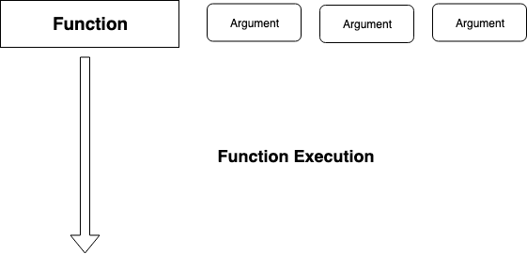
Currying

Slide 99
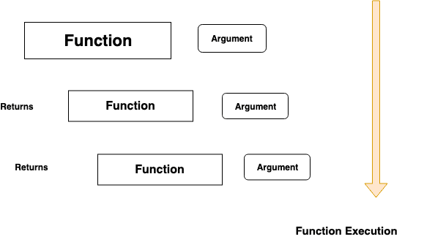
Currying
curry functions retains the state of the variable in it. it is called as Closure in javascript.

Slide 100
Currying
Currying is a transformation of functions that translates a function from callable as f(a, b, c) into callable as f(a)(b)(c).
Currying doesn’t call a function. It just transforms it.
Currying is a process in functional programming in which we can transform a function with multiple arguments into a sequence of nesting functions.
It returns a new function that expects the next argument inline.

Slide 101
Bind
A function declared in a class can be called through any instance of that class; but, what if we want a function which can perform only the task of one instance of that class and can be called without using that instance.
For this scenario, instead of writing a new function from scratch, we use the bind() method to create a modified copy of that function.
The first argument for the bind() method is necessary, and it is the object with which we want to bind our new copy of the function.
The keyword this, everywhere in the copy, will now refer to this bound object.

Slide 102
What exactly is a module?
Modules are the piece or chunk of a JavaScript code written in a file.
JavaScript modules help us to modularize the code simply by partitioning the entire code into modules that can be imported from anywhere.
Modules make it easy to maintain the code, debug the code, and reuse the piece of code.
Each module is a piece of code that gets executed once it is loaded.

Slide 103
JavaScript TypedArray
The JavaScript TypedArray object illustrates an array like view of an underlying binary data buffer.
There are many number of different global properties, whose values are TypedArray constructors for specific element types, listed below.
Types of TypedArray
Int8Array
Size in bytes: 1
Description: 8-bit two's compliment signed integer.
Type: byte.
Value Range: -128 to 127

Slide 104
JavaScript TypedArray
Unit8Array
Size in bytes: 1
Description: 8-bit two's compliment signed octet.
Type: octet.
Value Range: 0 to 255.
Unit8ClampedArray
Size in bytes: 1
Description: 8-bit unsigned integer (clamped) octet.
Type: octet.
Value Range: 0 to 255.

Slide 105
JavaScript TypedArray
Int16Array
Size in bytes: 2
Description: 16-bit two's complement signed integer.
Type: short.
Value Range: -32768 to 32767.
Unit16Array
Size in bytes: 2
Description: 16-bit unsigned integer.
Type: unsigned short.
Value Range: 0 to 65535.

Slide 106
JavaScript TypedArray
Int32Array
Size in bytes: 4
Description: 32-bit two's complement signed integer.
Type: long.
Value Range: -2147483648 to 2147483647.
Uint32Array
Size in bytes: 4
Description: 32-bit unsigned integer.
Type: unsigned long.
Value Range: 0 to 4294967295

Slide 107
JavaScript TypedArray
Float32Array
Size in bytes: 4
Description: 32-bit IEEE floating point number unrestricted float.
Type: unrestricted float.
Value Range: 1.2x10-38 to 3.4x1038
Float64Array
Size in bytes: 8
Description: 64-bit IEEE floating point number unrestricted double.
Type: unrestricted double.
Value Range: 5.0x10-324 to 1.8x10308

Slide 108
Spread vs Rest
spread operator unpacks elements.
rest parameter packs elements.

Slide 109
Namespace
The solution to this is to have wrap all the variables and functions in a javascript file into one namespace, namely one variable/object per javascript file.

Slide 110
CORS
Npm install –g yarn
$ yarn global add serve
$ serve ./

Slide 111
Iterators
ES6 introduces a new way to interact with JavaScript data structures — iteration.
There are 2 core concepts:
Iterable — described by a data structure that provides a way to expose its data to the public.
This is done by implementing a method whose key is Symbol.iterator.
Symbol.iterator is a factory of iterators.
Iterator — described by a structure that contains a pointer to the next element in the iteration.

Slide 112

Iterators

Slide 113
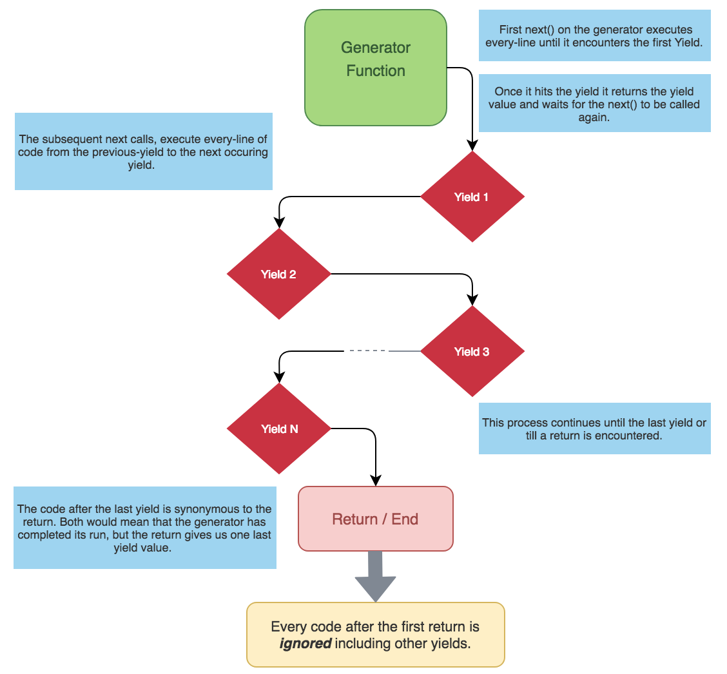
Generators

Slide 114
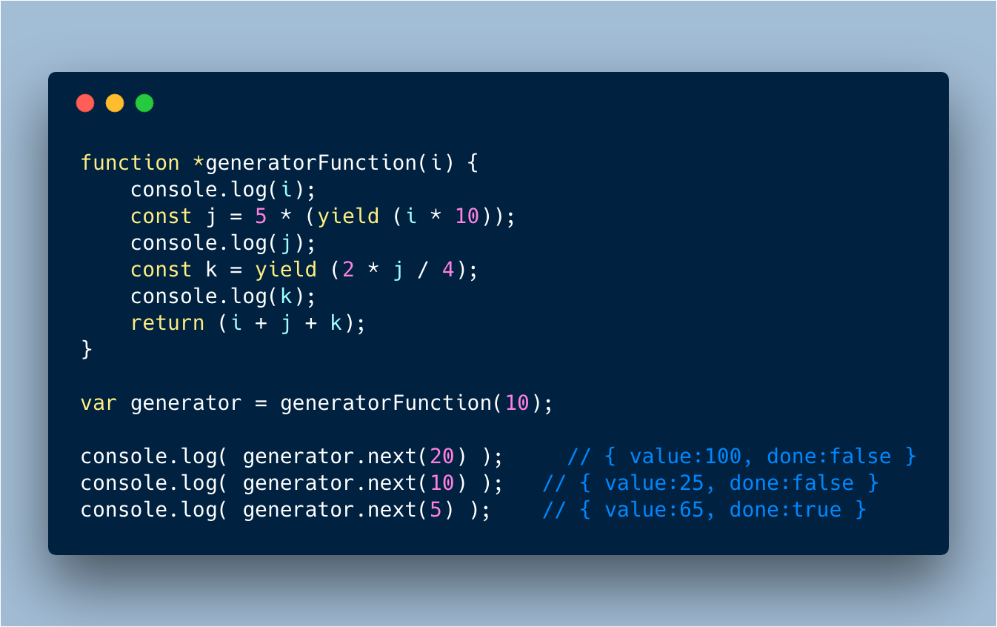
Generators

Slide 115
Questions

Slide 116
Module Summary

